Slide 1

ACM Update
Vicki Hanson
SGB (Virtual) Meeting
8 October 2021

Slide 2
Membership
 | 30 Sept 2021 | 3 Sept 2020
Professional Members | 83,379 | 74,543
Student Members | 27,812 | 19,135
Total ACM Members | 111,191 | 93,678
ACM + SIG members | 23,548 | 22,741
SIG-only Members | 9,681 | 8,613
Total SIG Members | 33,229 | 31,354

Slide 3
ACM Digital library

Slide 4
Strategic Focus on the ACM Digital Library
2020 Presidential Task Force on DL
  Looked broadly at updating DL to remaining current
DL plan approved by the ACM EC on 7 Jan 2021:
  Provide focused effort on the DL
    Elevate DL visibility and importance in ACM hierarchy
  Digital Library Department at Headquarters
  Volunteer oversight through new DL Board

Slide 5
Digital Library Board
New DL Board was approved by ACM Council June 2021
Board membership
  Chair, Jack Davidson
  Members, global ACM members who are authors and DL users
The Publications and DL Board Chairs have been delineating the responsibilities of each Board
Oversight responsibilities for design and operation of DL
  Advocating for end users
  Providing input on functionality and priorities
  Providing feedback on user experience including central reporting, UI, and Search
  Providing guidance on new possibilities

Slide 6

DL Early Progress
Tracking of feedback
Journals
  Full text XML
Author profiles
  Corrections
  ORCID
  Claim publications
Normalization
  Author names
  Affiliations
ACM Just Accepted
  Journals
  After copyedit
  With DOI into publication

Slide 7

DL Early Progress
Tracking of feedback
Journals
  Full text XML
Author profiles
  Correct errors
  ORCID
  Claim publications
Normalization
  Author names
  Affiliations
ACM Just Accepted
  Journals
  After copyedit
  With DOI into publication

Slide 8
DL Early Progress
Tracking of feedback
Journals
  Full text XML
Author profiles
  Correct errors
  ORCID
  Claim publications
Normalization
  Author names
  Affiliations
ACM Just Accepted
  Journals
  After copyedit
  With DOI into publication

Slide 9

DL Early Progress
Tracking of feedback
Journals
  Full text XML
Author profiles
  Correct errors
  ORCID
  Claim publications
Normalization
  Author names
  Affiliations
ACM Just Accepted
  Journals
  After copyedit
  With DOI into publication

Slide 10
DL Early Progress
Tracking of feedback
Journals
  Full text XML
Author profiles
  Correct errors
  ORCID
  Claim publications
Normalization
  Author names
  Affiliations
ACM Just Accepted
  Journals
  After copyedit
  With DOI into publication
Notes:
New functionality

Slide 11
Acm and sig awards

Slide 12
ACM Awards Committee
ACM formally recognizes individuals for significant contributions to the field, ACM, or its interests. This recognition includes ACM Awards, Advanced Member Grades, and SIG Awards, collectively termed Honors
Adjustments to Awards process
  New Honors Policy
    Commitment to ethical conduct is required for recipients of all ACM awards and ACM SIG awards
      Will not confer an honor on individual in violation of Code
      Will defer conferring in cases where there a credible question
    Earlier deadlines for enhanced scrutiny
    Right to grant, decline or revoke an Honor
  Nominators and Endorsers requirement
Wide distribution of Call for Nomination for diversity
SIG Awards need to follow these guidelines

Slide 13
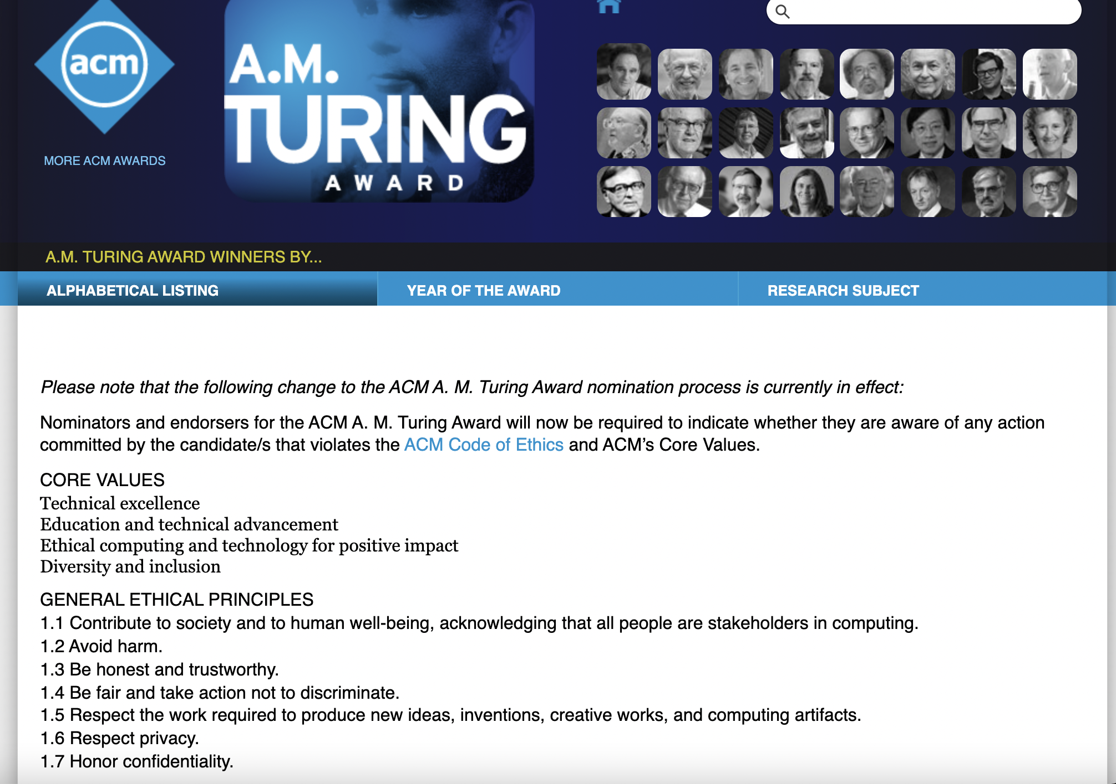

Slide 14
ACM Awards Committee
ACM formally recognizes individuals for significant contributions to the field, ACM, or its interests. This recognition includes ACM Awards, Advanced Member Grades, and SIG Awards, collectively termed Honors
Adjustments to Awards process
  New Honors Policy
    Commitment to ethical conduct is required for recipients of all ACM awards and ACM SIG awards
      Will not confer an honor on individual in violation of Code
      Will defer conferring in cases where there a credible question
    Earlier deadlines for enhanced scrutiny
    Right to grant, decline or revoke an Honor
  Nominators and Endorsers requirement
Wide distribution of Call for Nomination for diversity
SIG Awards need to follow these guidelines

Slide 15

ACM Awards
https://europe.acm.org/

