Slide 1

Virtual ISCA 2020
May 29th - June 3rd
José Martínez & José Duato, General Co-Chairs
https://iscaconf.org/isca2020/
SGB Meeting
Best Practices for Virtual Meetings Zoom Webinar

Slide 2
Some key decisions
Registration fees: Same low fees for authors and attendees ($30, $60 for non-members, $15 for students)
Physical conference in 2021, same place and same GCs
Three time slots: Main at 10:00-12:00 (NYC) + 12:00-14:00 + 20:00-22:00
Flipped format: pre-recorded presentations and Q&A-heavy sessions
Virtual coffee breaks (12 mini-panels)
Choice of tools: Whova + Zoom + Wistia

Slide 3
ISCA 2020 Preliminary Budget
Expenses:
  Program committee meeting -$12,000
  Proceedings -$2,200
  Whova platform -$2,200
  Zoom webinar support -$3,000
  Video platform (China-accessible) -$1,500
  Misc. -$1,000
  ACM/IEEE CS admin fee -$3,500
  Venue cancellation fees -$15,000 (averted b/c ISCA 2021)
Revenue:
  Industry sponsors $0 (all deferred for ISCA 2021)
  SIGARCH $7,500 (borrowed against ISCA 2021)
  TCCA $7,500 (borrowed against ISCA 2021)
  Registration (1701 attendees) $38,000

Slide 4
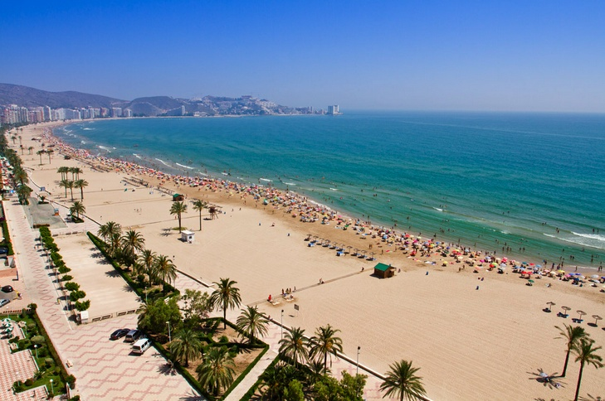


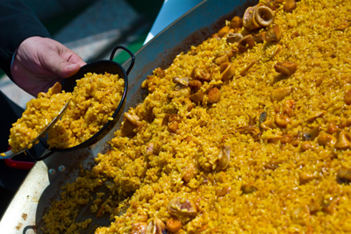

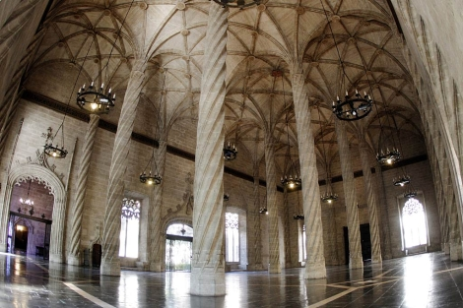
2021
To be held in Valencia, Spain. Current status:
  Renegotiation of all venue contracts without penalty
  Porting of all industry sponsor funds without any retractions
  Dates moved up one week; same great weather
  Still same awesome venue and food
  Plans for a hybrid format: physical conference + virtual access

Slide 5
Software Tools
Choice of tools: Whova + Zoom + Wistia
Whova: registration + agenda + access to papers, pre-recorded presentation videos, and recordings of live sessions + off-line questions
Zoom webinar: Live sessions + on-line Q&A
  Two streams for 3,000 people for main track + two 1,000 people streams for workshops and tutorials
Wistia: for broadcast bandwidth. Not banned in China, etc. Enabled pausing, replaying, etc

Slide 6
Credits
José Martínez, General Co-chair and main contributor to key decisions and conference success
Lieven Eeckhout, Program Chair and main organizer behind mini-panels and flipped sessions
Samira Khan and José Renau, main contributors to the success of workshops and tutorials
Saugata Ghose, Web Chair, and Josué Feliu and Lucía Pons, Global Arrangements Co-Chairs, took care of most of the extra work of running a virtual conference
The entire organizing committee. Thank you!!!

